Slide 1
Laying Out the Board
Dr. Steven Swanson
CSE176e/276e
swanson@cs.ucsd.edu

Slide 2
Board Layout Goals
Mechanical constraints – Some things need to be in specific locations
Electrical constraints – Does the layout meet signal integrity/EM requirements
Will digital interference mess up the antenna?
Are decoupling caps near IC Supply pins?
Keep the noisy power/ground for the motors away from the digital logic.
Correctness – things don’t overlap or hang off the board.
Ease of routing – Connected items should be physically close.
Make it pretty – you want a nice-looking board
Potentially other, design-specific requirements

Slide 3
Layout Steps
Define board shape.
Place mechanically important parts
Define power planes
Place other parts
Route the board
Run DRC

Slide 4
Keeping Your Design Synchronized
It’s important to keep your .brd and .sch files synchronized.
If they get unsynchronized, it can be very hard to fix.
Unfortunately, Fusion360 makes this harder than it should be.

Slide 5
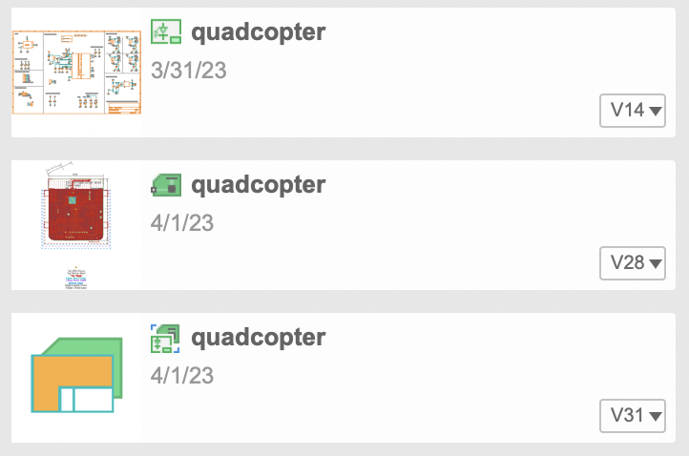
The Three Files In Your Project
Schematic – your schematic
Board – your board
Project – the link between them
Always open the project file
This will open the schematic and board together.
It will keep them synchronized.
If you upload a new design, you must upload both .sch and .brd
Schematic
Board
Project

Slide 6
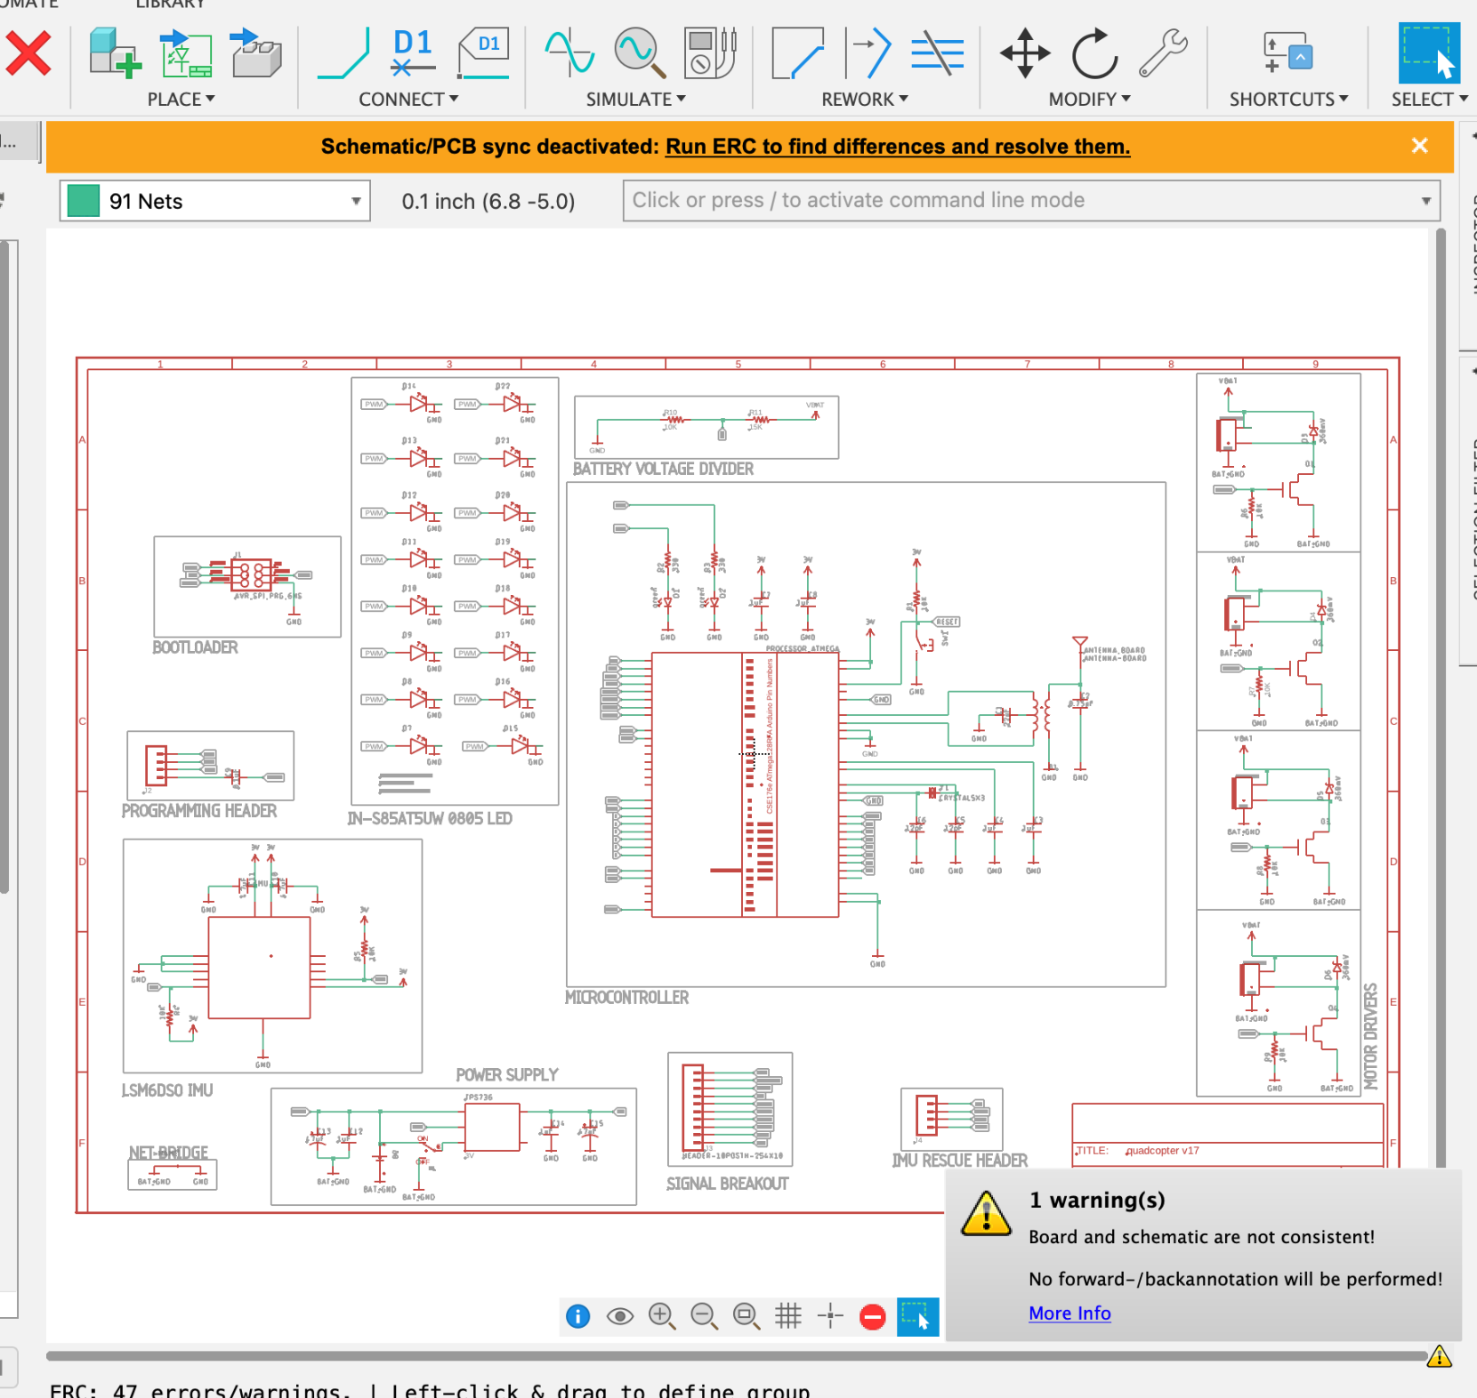
If They Become Unsynchronized
Stop!
Run ERC.
It will show you the differences.
Save your work. Try to fix them.
If you can’t, post on piazza.

Slide 7
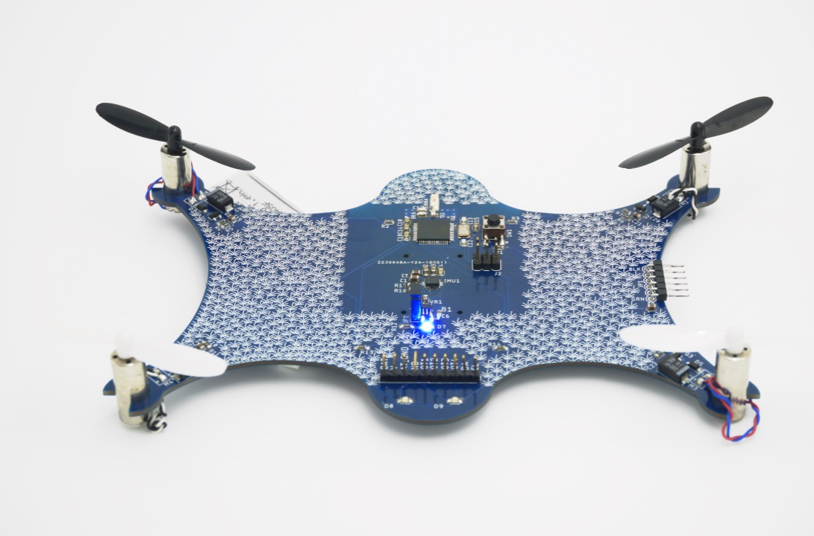
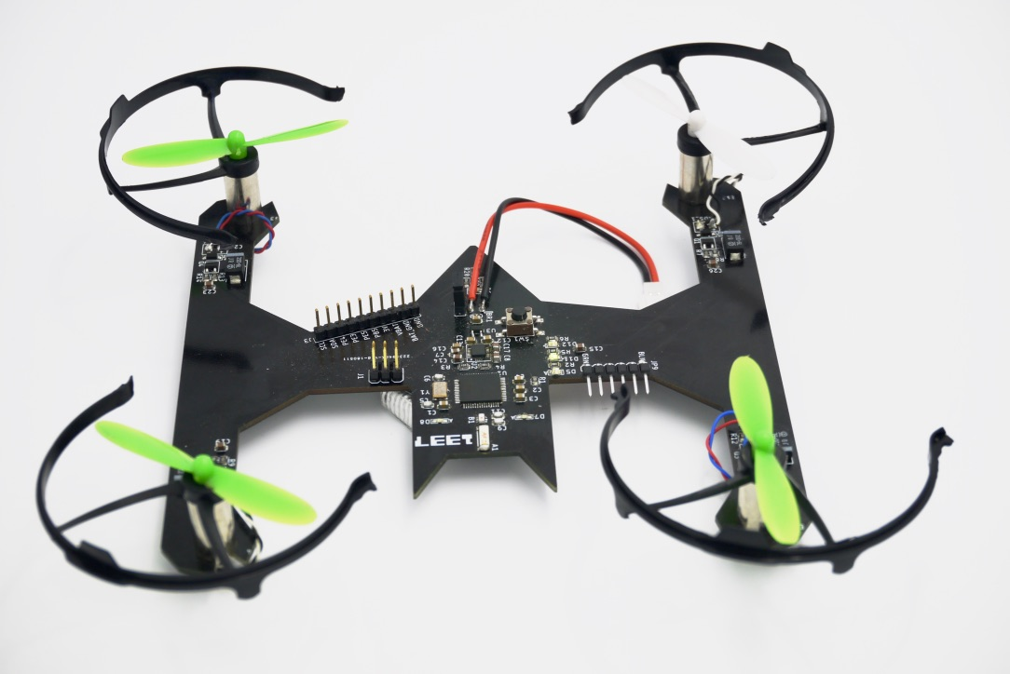
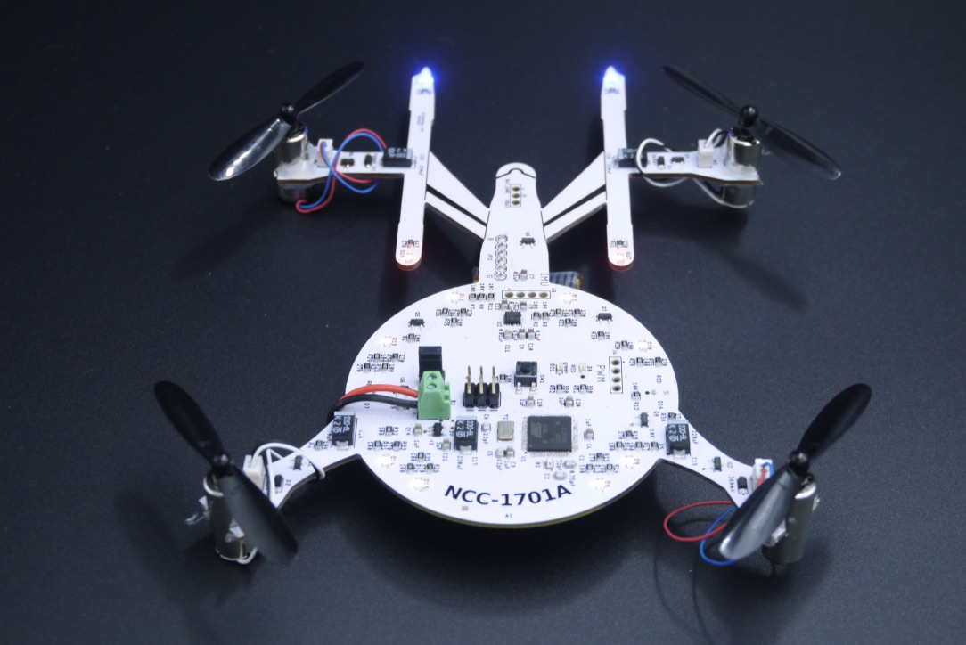
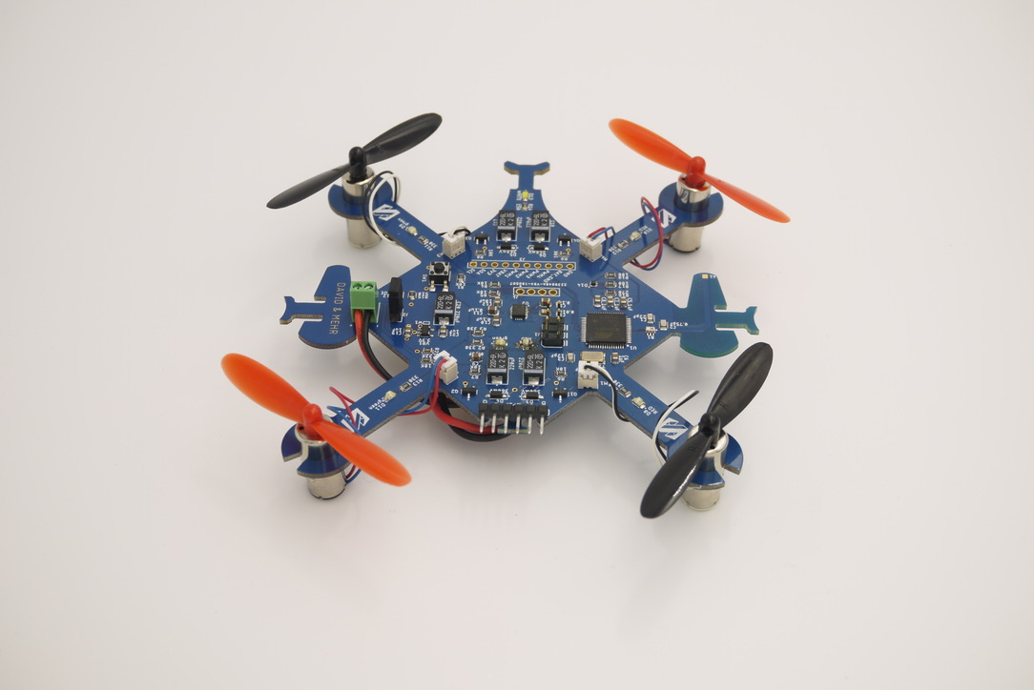
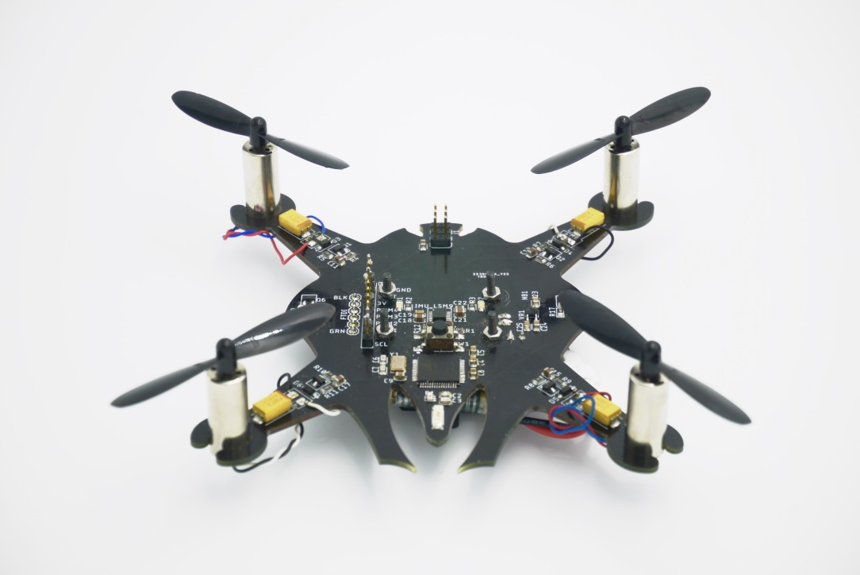
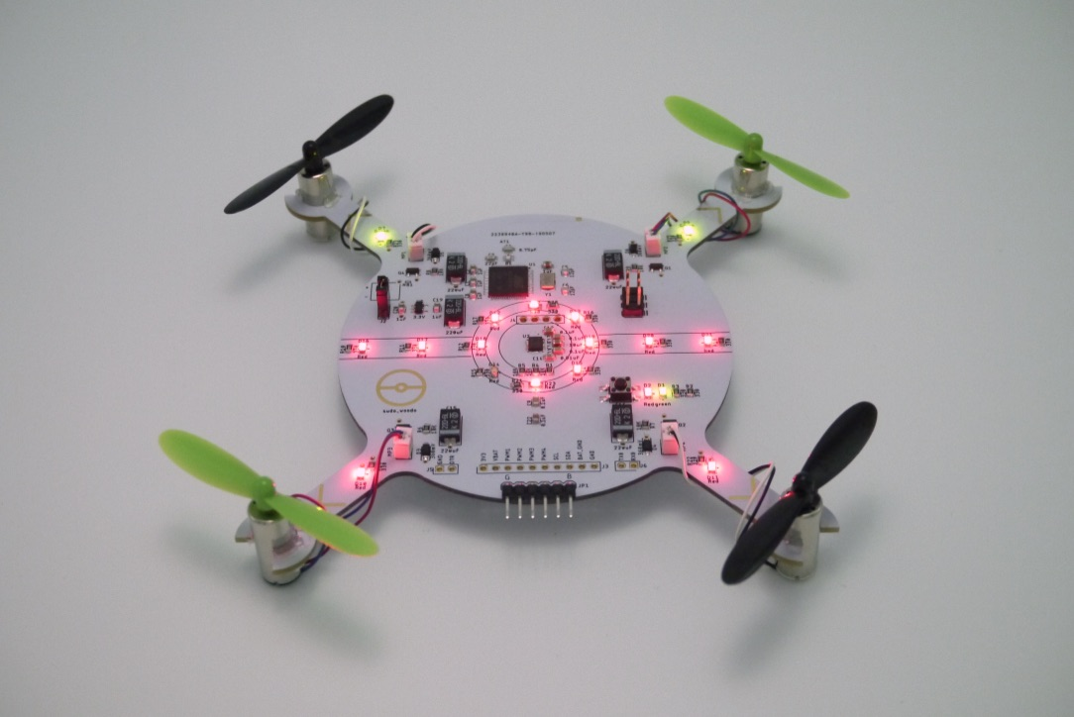
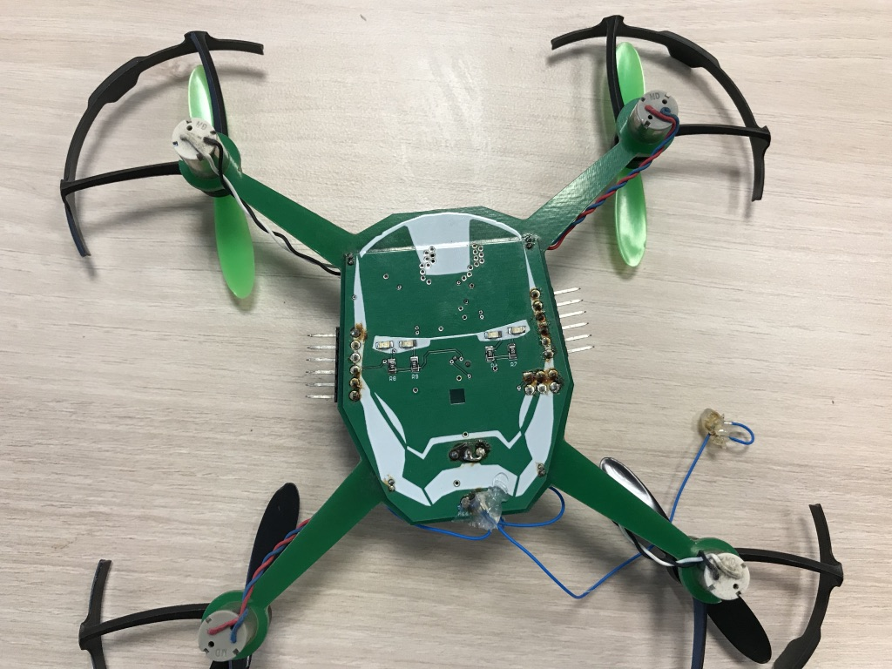
Board Shape
Be creative!
Have a theme!
Place the motor symmetrically
Build rings for motor mounts

Slide 8
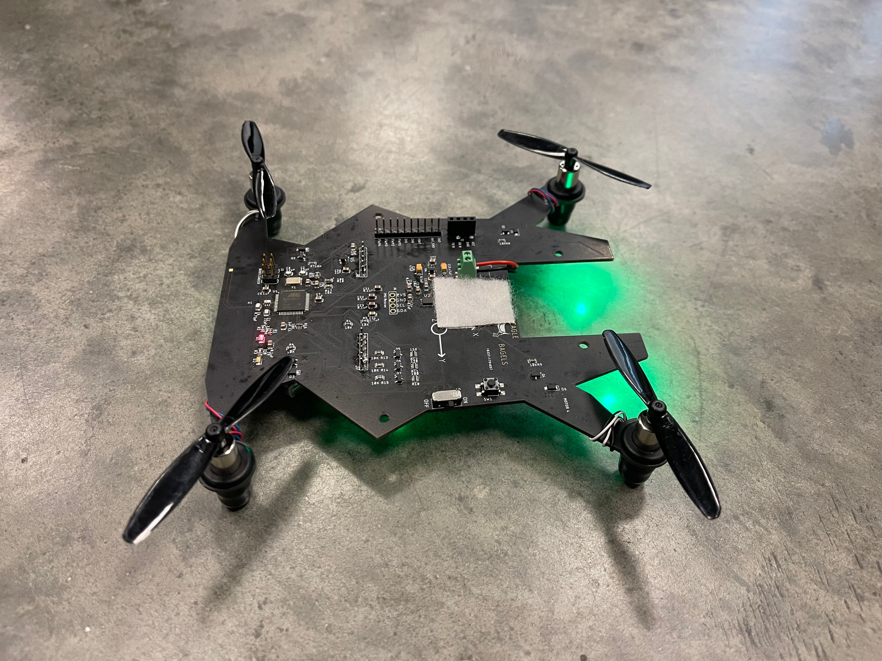
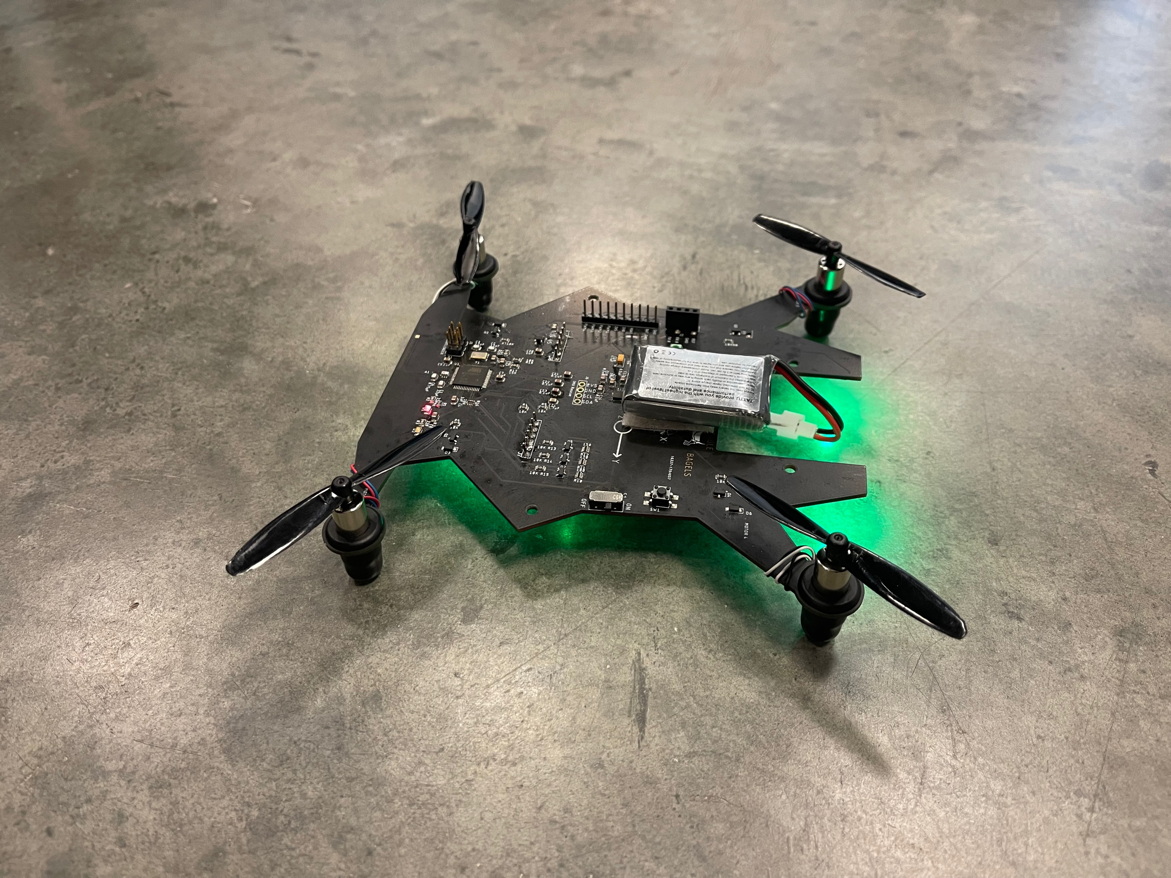
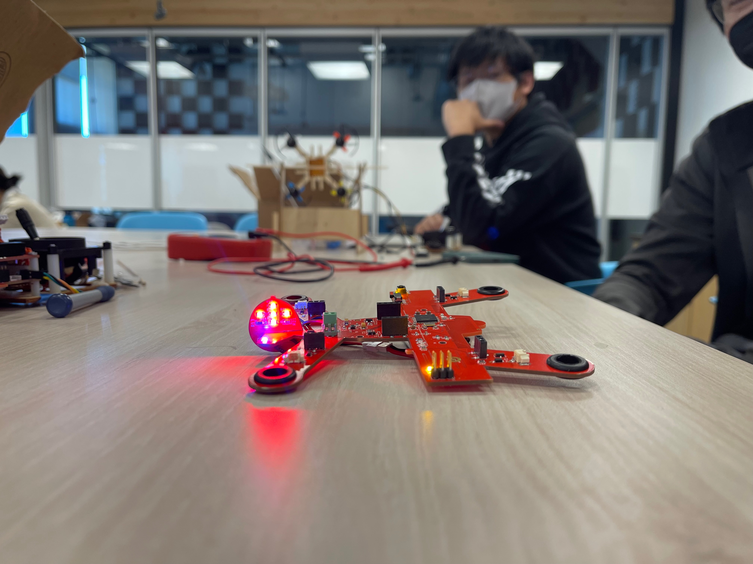
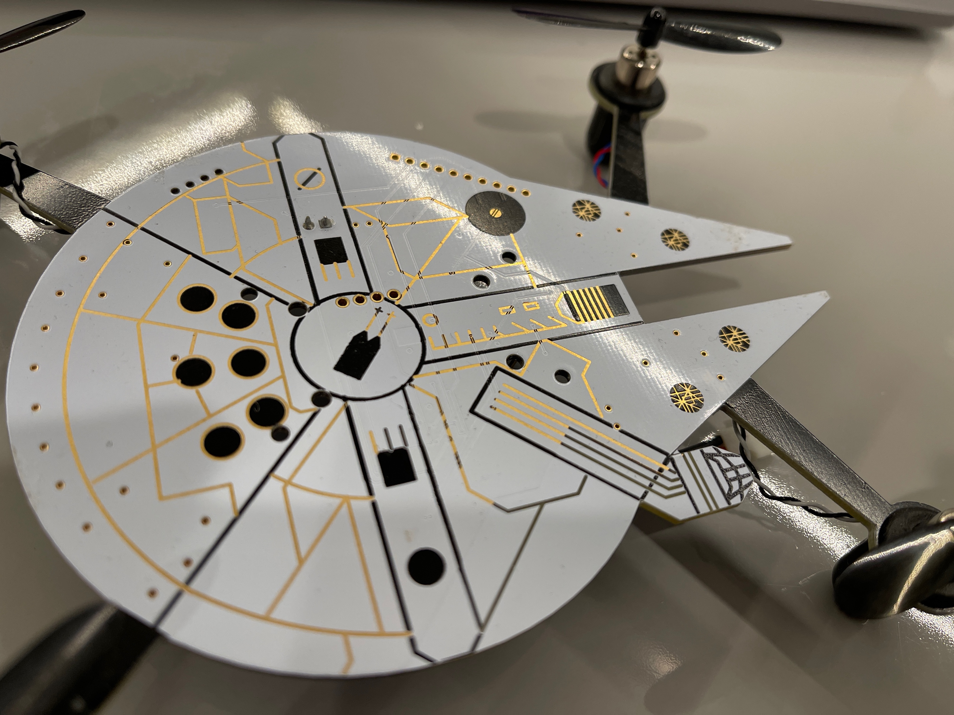
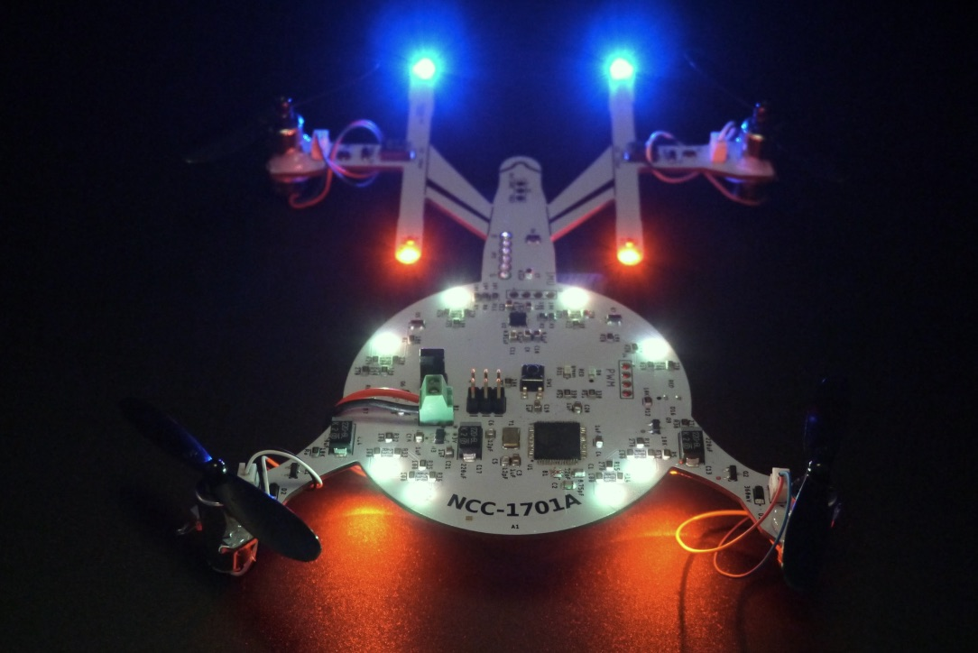
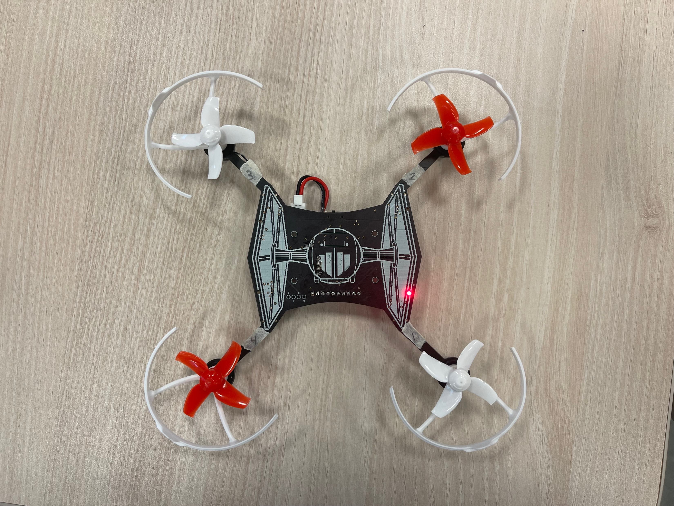
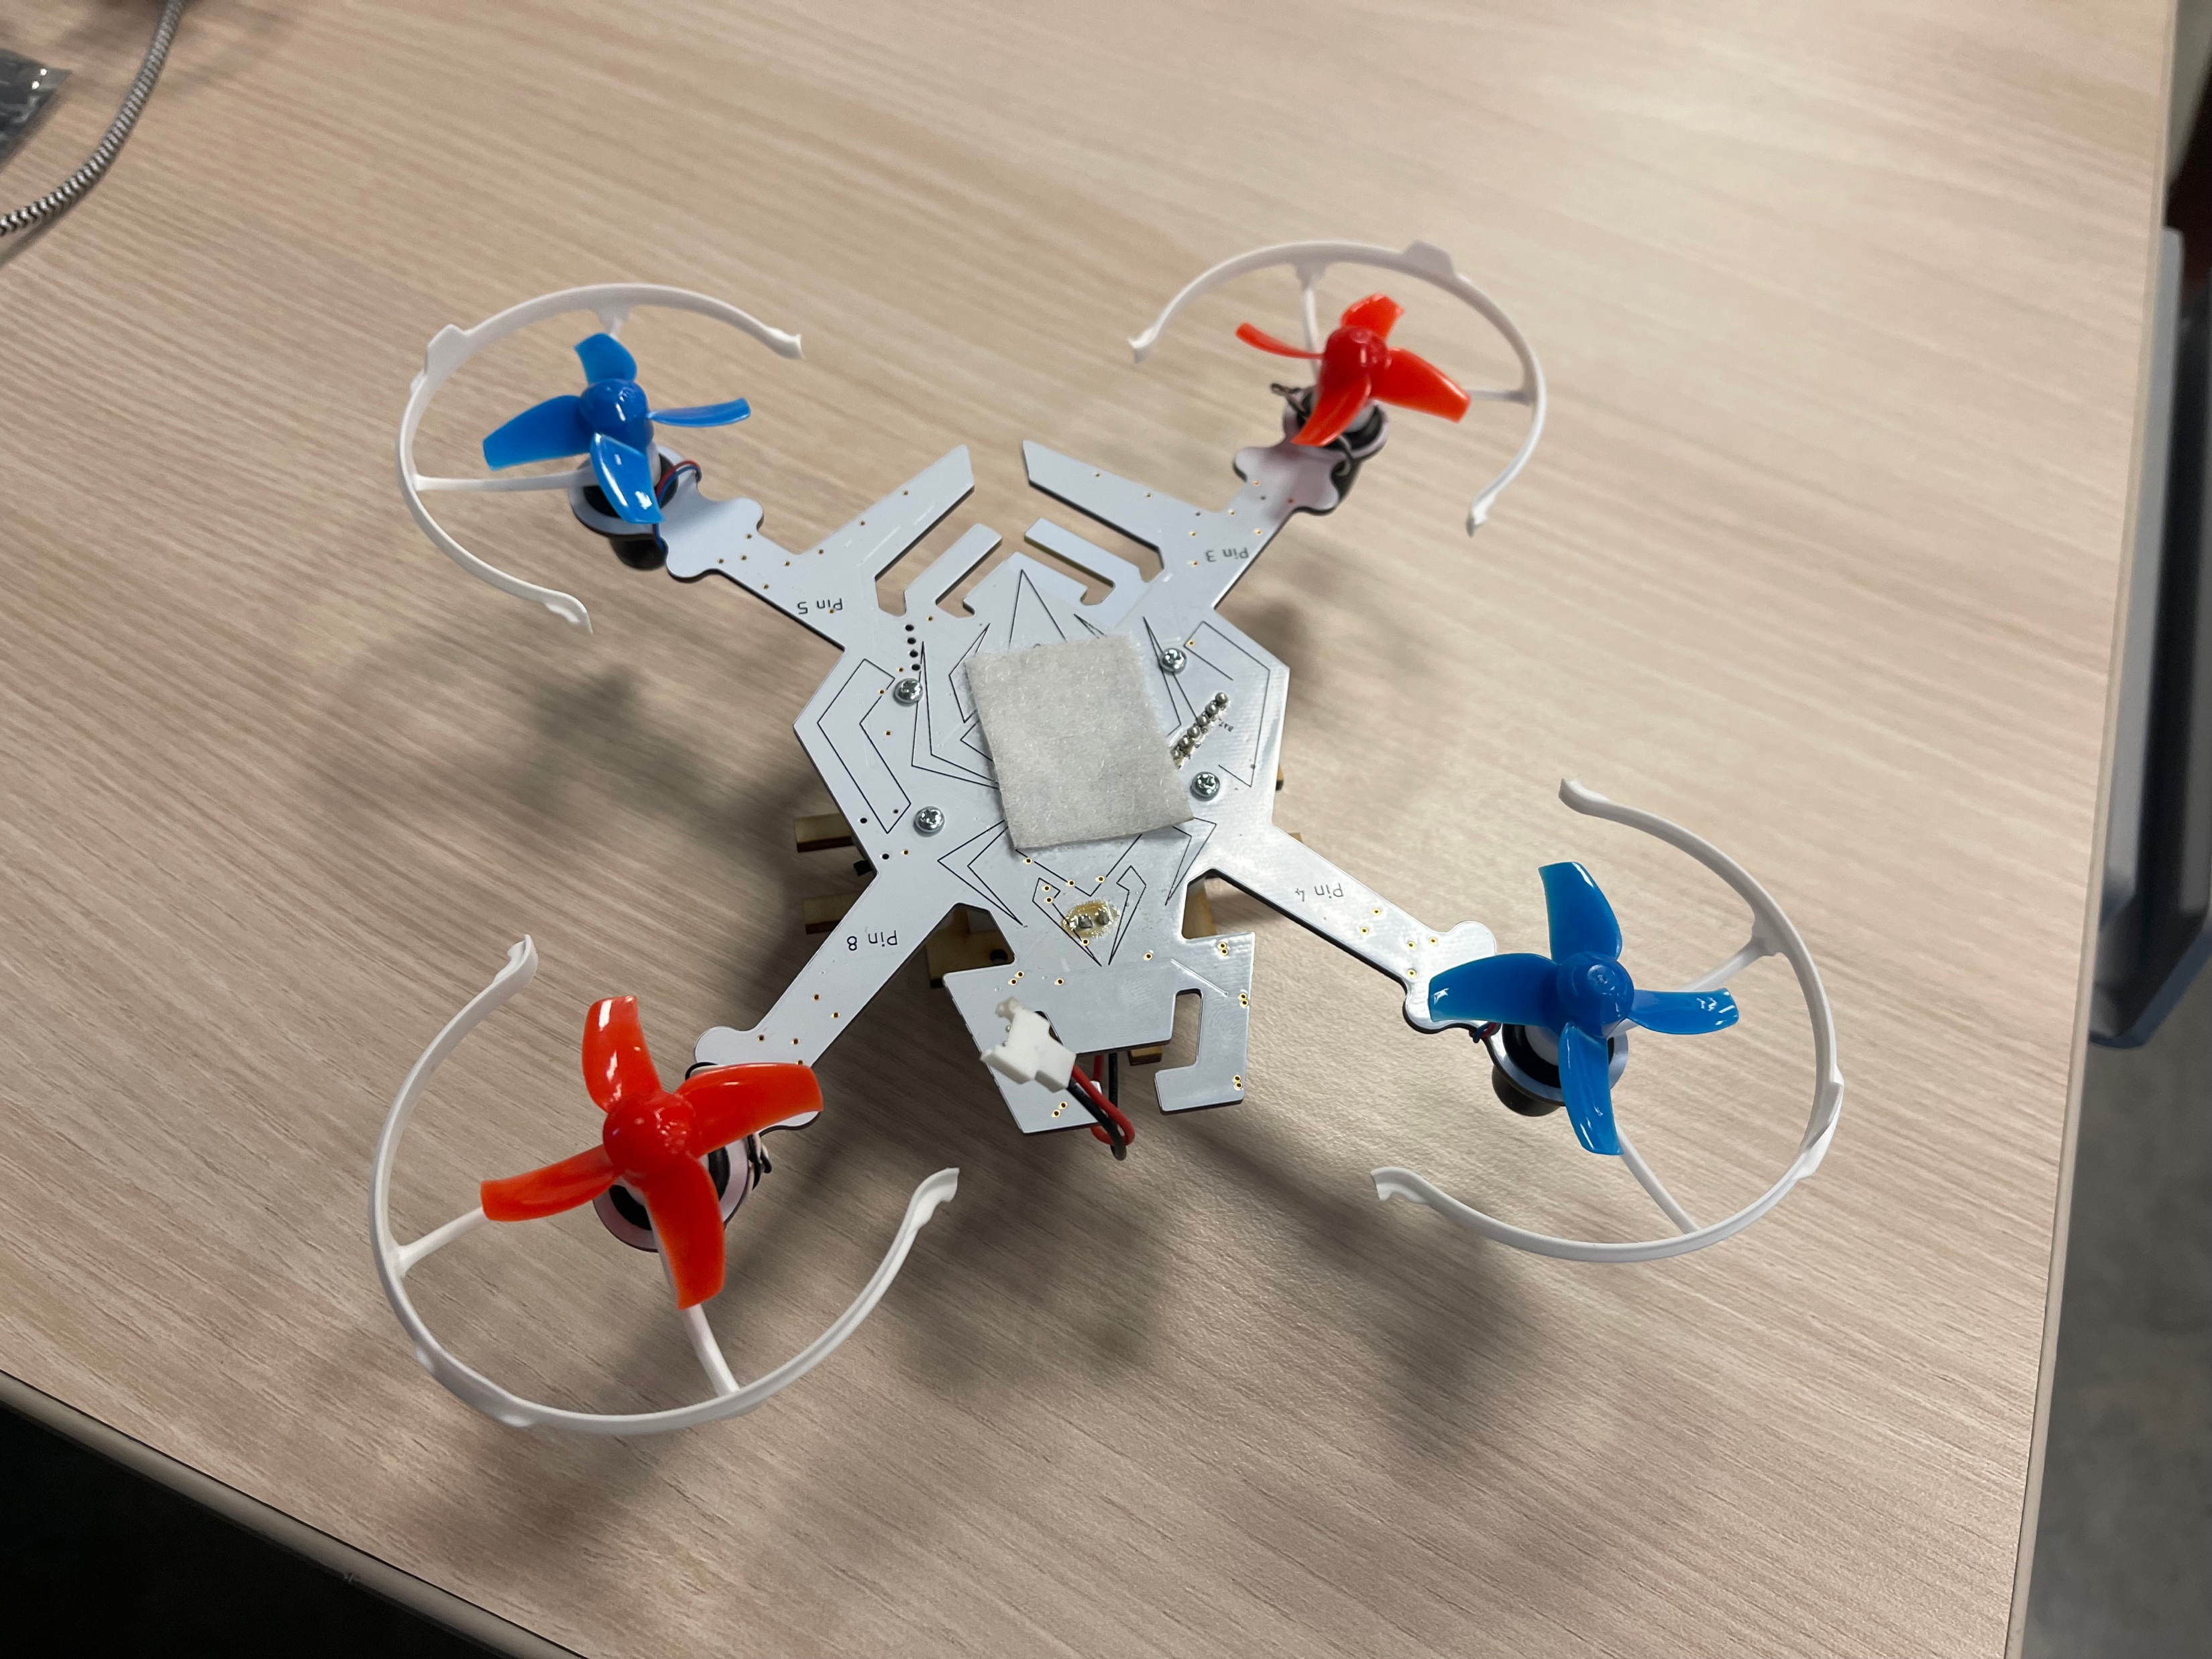
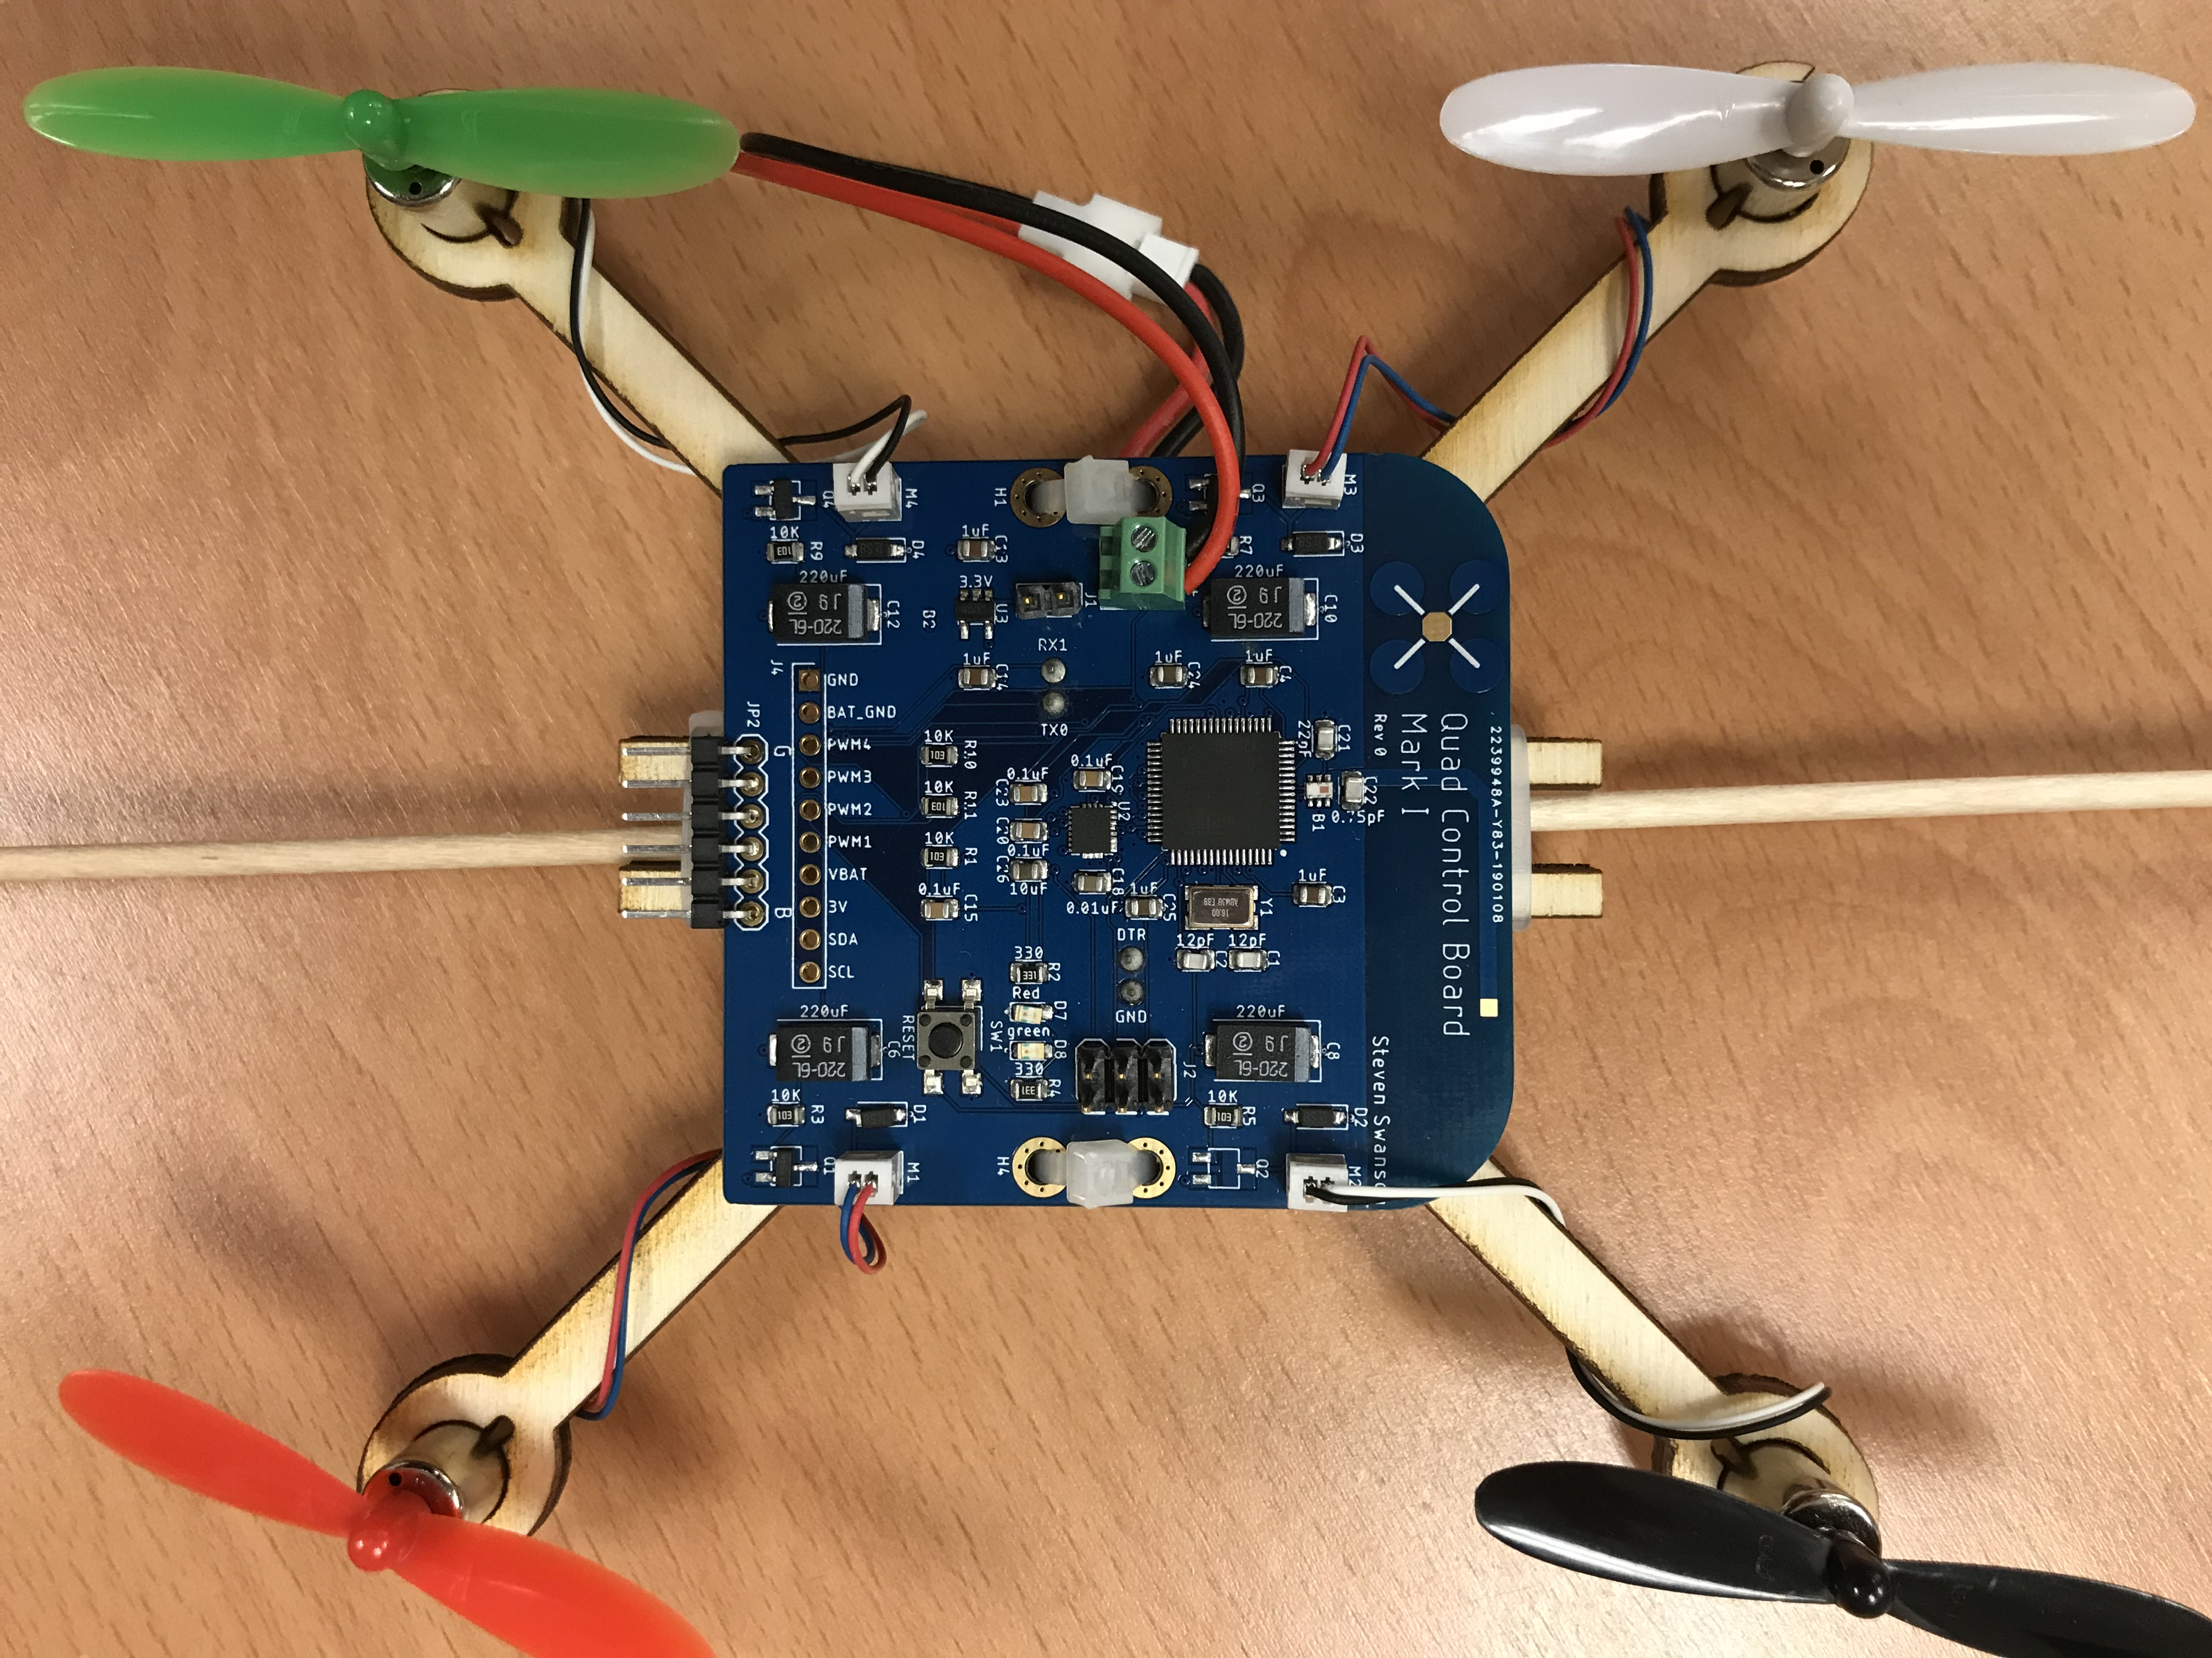
Logos and Artwork
You can put whatever you want in tPlace
Give your quadcopter personality!
You can also design in metal and solder mask
Silkscreen -- white
Metal -- gold
Metal + solder mask – bright color
Solder mask – darker color
No metal, no mask – beige-ish
Checkout the quadcopter logo on the boards for the class

Slide 9
q

Slide 10
Placing the Motors
The motors need to be symmetrical about the roll and pitch axes.
This means they need to form a rectangle
With four motors 2 configurations are possible
X
+
“Plus”
“X”
Hexa +
Hexa x
Octa +
Octa x
“Octothorpe”
Y 6

Slide 11
Part Placement

Slide 12
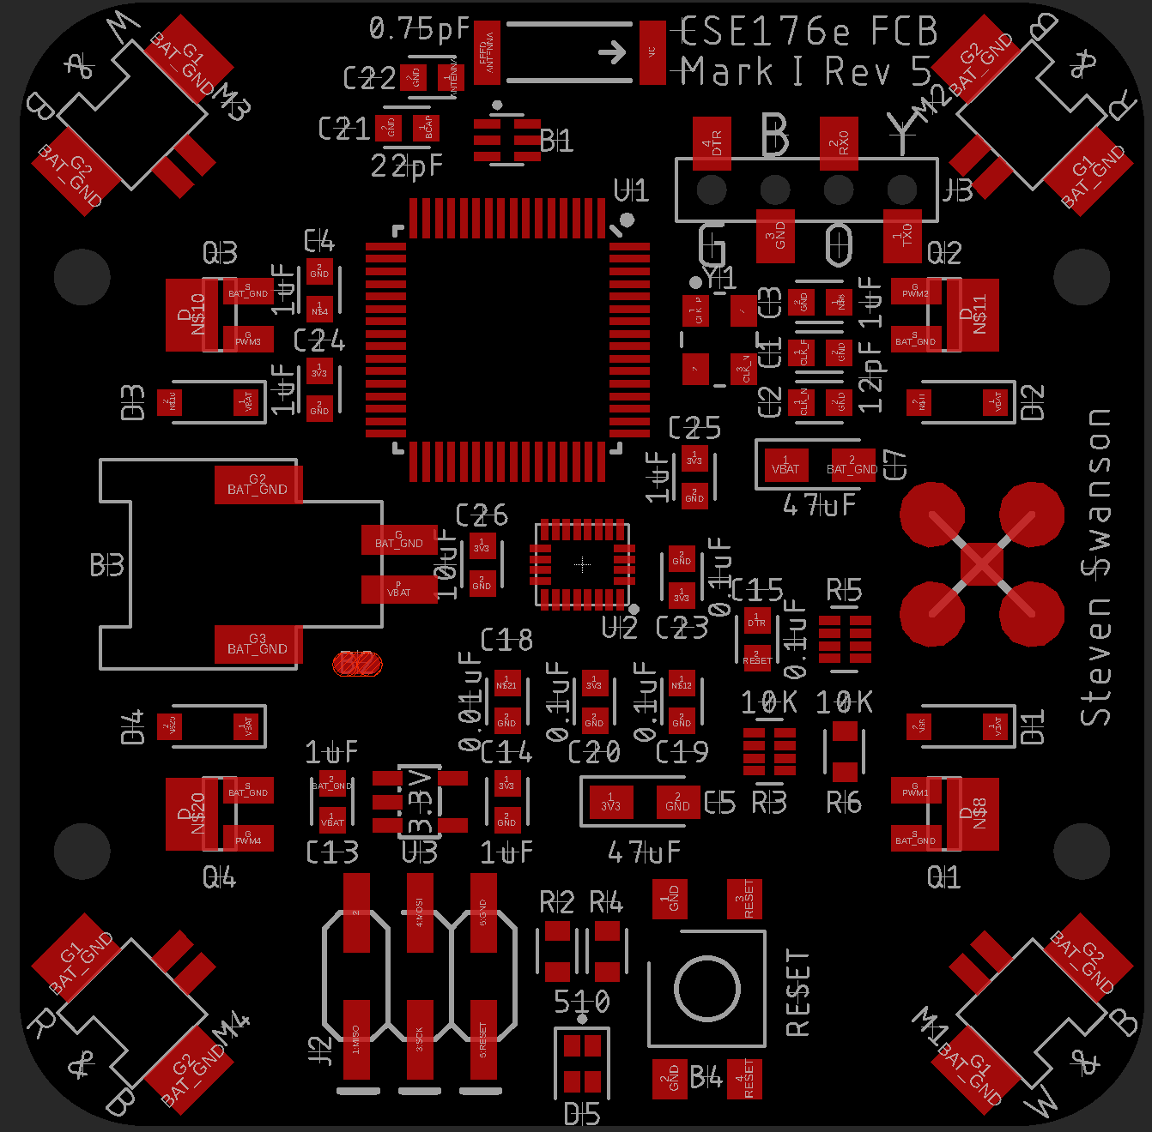
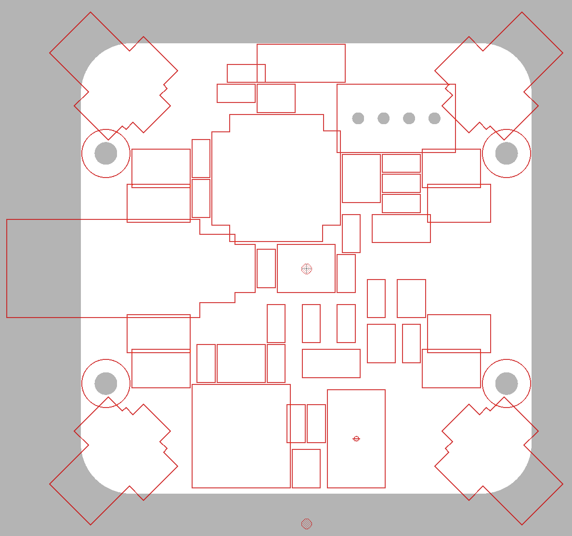
Device Placement: Style
Put all your components on a 0.5mm grid
Except for critical areas like the antenna driver.
Reference designators can go on 0.5 or 0.1mm grid.
Orient all your parts the same way for easy assembly.
If you want
It makes it marginally easier to place parts
Leave space between components for easy assembly
If you’ve followed the guidance on tKeepout, this will be automatic
Make it pretty!
tKeepout

Slide 13
Placing the IMU
The IMU should be roughly at the board center of mass.
Placing it at the origin is a good choice
Then place the motors symmetrically around it.
The orientation of the IMU is important.
It’s axes of measurement (see the data sheet) need to correspond to pitch, yaw, and roll for your quad.

Slide 14
Placing the Antenna
The antenna should be on the edge of the board
No metal near by
It will determine the location of your microcontroller.
You must follow the reference design to layout the antenna driver and MCU

Slide 15
Power and Ground

Slide 16
Motor Power: Resistance
Motors take a lot of current!
We want all the power to go to the motors
Copper is an imperfect conductor
Voltage drop on power lines is non-trivial
Resistance is a function of aspect ratio
0.5 mΩ/square
So, make the power lines wide!
Use a trace-width calculator
https://www.4pcb.com/trace-width-calculator.html

Slide 17
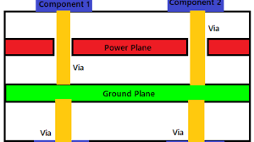
Power and Ground Planes
Power planes are large areas of metal for carrying power and ground
Low-resistance
Low-inductance
High-capacitance
Ground planes help with decoupling
Designing them in complex circuits is a whole discipline

Slide 18
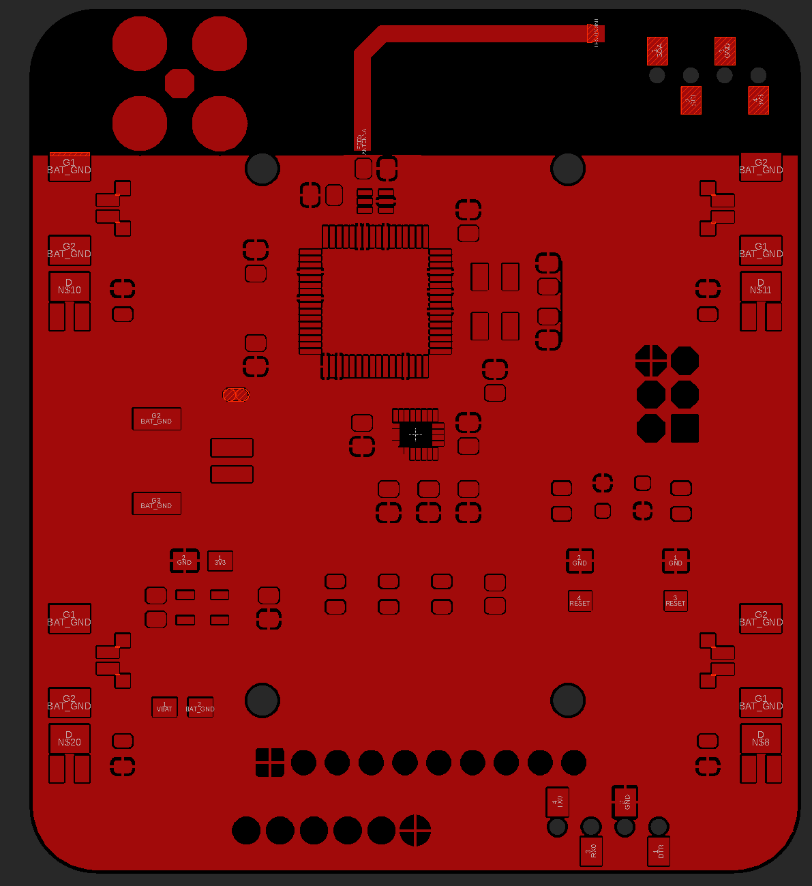
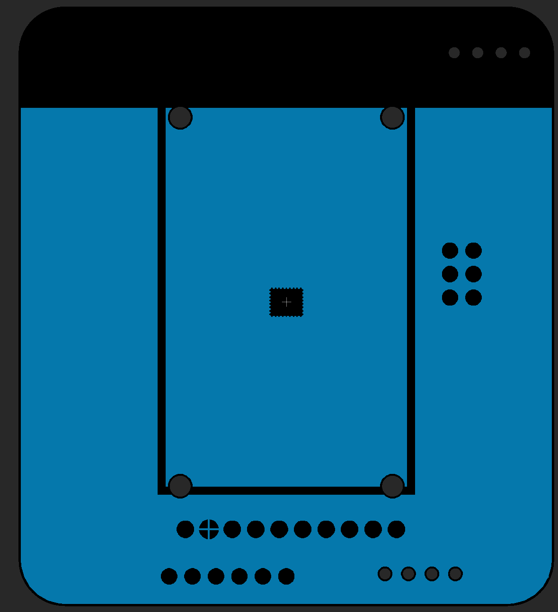
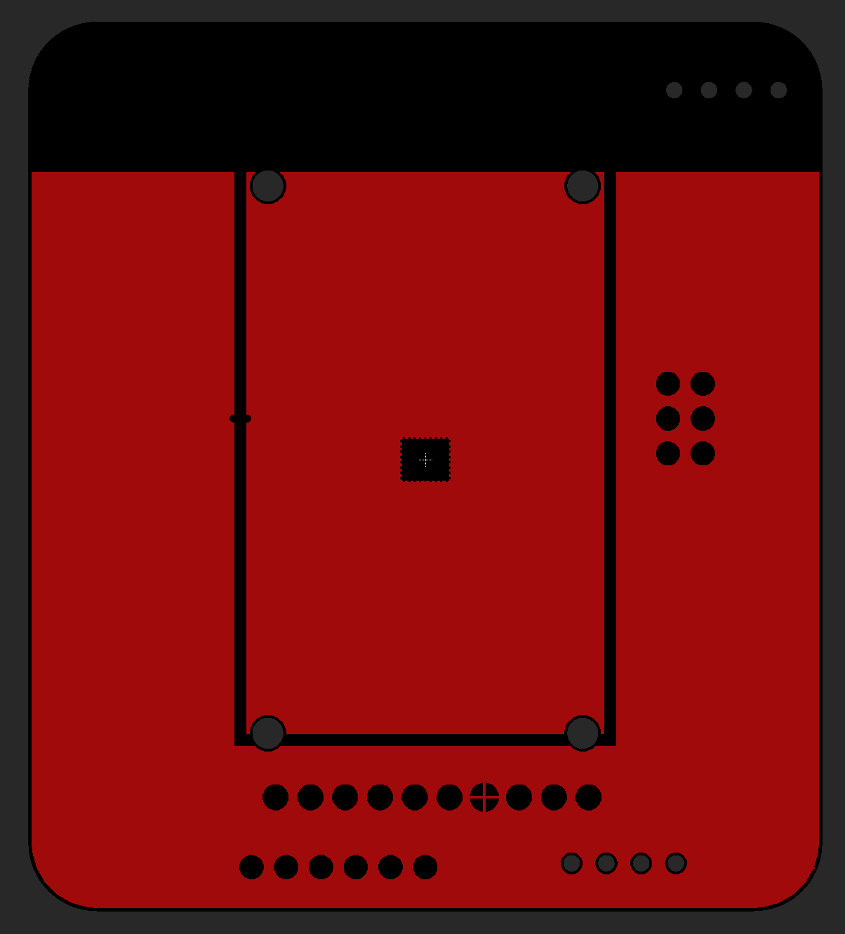
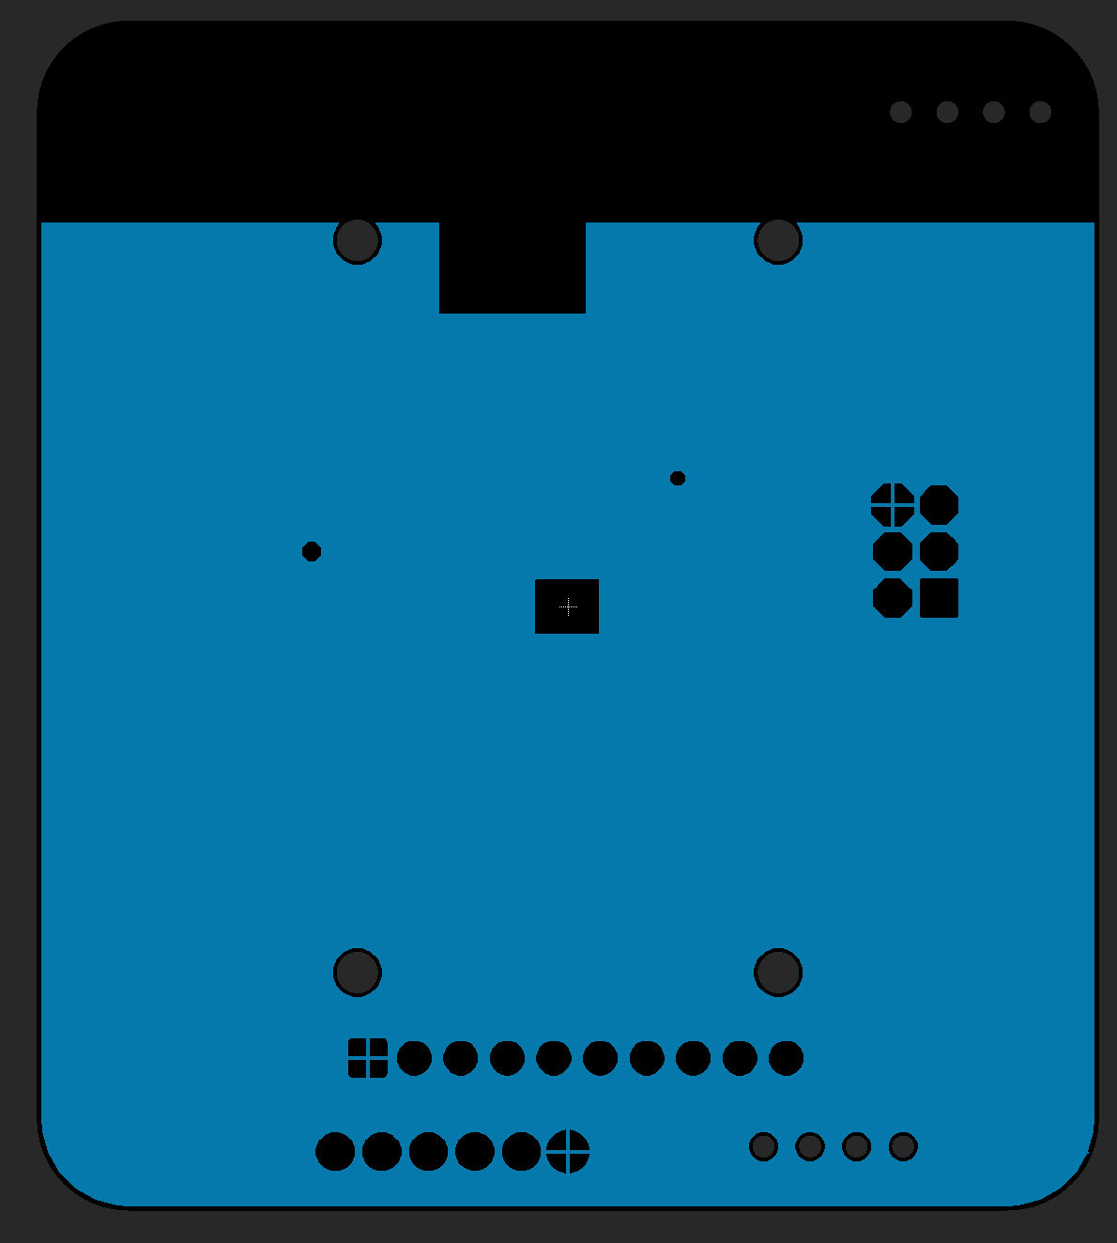
In Your Quadcopter
Top: GND
GND planes on top and bottom
Internally
One power one ground
One pair for regulated, one pain for battery
Battery plane
Pretty wide everywhere (low resistance)
It should connect the battery and the motor drivers
There should be long traces – mostly vias
Regulated plane
Should cover the MCU and IMU and vreg
MCU and IMU power should be vias
Route 2: BAT_GND and GND
Route 15: VBAT and 2V5
Bottom: GND

Slide 19
Decoupling Caps
Decoupling caps in the data sheets must be near the devices they are for
MCU
IMU
Voltage regulator
The two 47uF caps should be centrally located on their respective power/ground planes
VBAT/BAT_GND
3V/GND

Slide 20
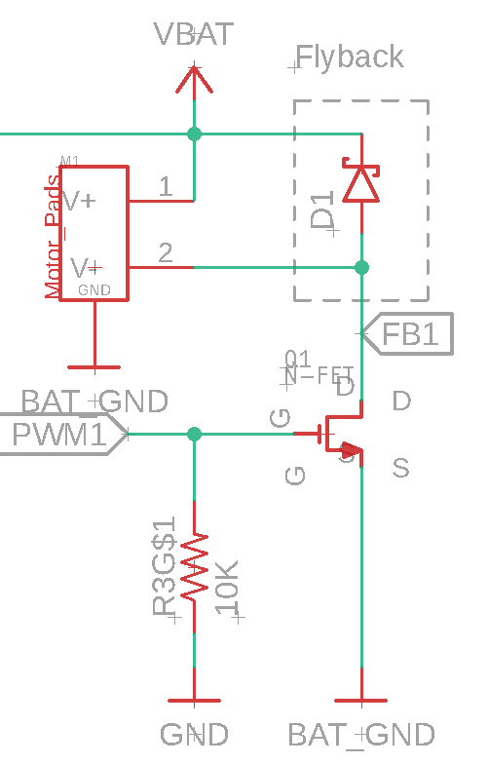
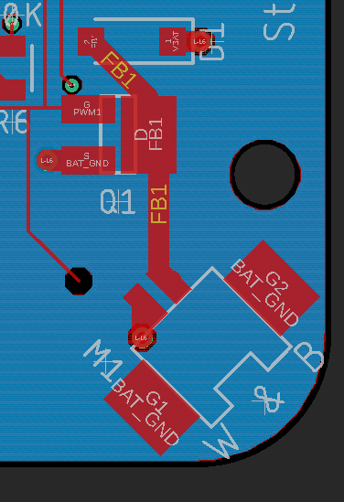
High Current Traces
VBAT
BAT_GND
Motor Drivers
One trace in each motor driver (FB1)
Current come in on big vias and wide traces from VBAT
Traverses MOSFET, motor, and FB1
Current leaves via big vias and wide traces to BAT_GND
PWM1 is thin, because it’s low current
(The BAT_GND connections on the motor is mechanical only)

Slide 21
Routing

Slide 22
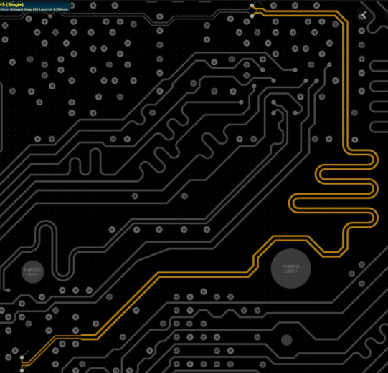
Differential Pairs
These carry high-speed signals
USB
HDMI
PCIe
The radio output from the MCU
Two wires running parallel to each other
Similar electrical characteristics
Subject to similar interference
Reduced EMF interference
Name them with ’_N’ and ‘_P’ in Fusion

Slide 23
The Antenna
Our antenna is a strip of copper.
It is ~1/4 the wavelength of the 2.4GHz radio signal
It should be smooth
No sharp corners
They cause reflections at high speed

Slide 24
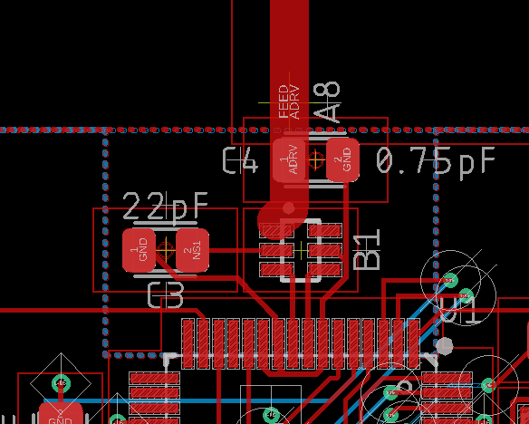
The Antenna Driver
Note the short symmetrical differential pair from the MCU to the balun
Note the smooth, strait, wide trace from the balun to the antenna
No creativity here. We don’t have the equipment or software to debug problems.

Slide 25
The Three Ways to Route
Auto router
Fully-automatic routing, subject to constraints that you can set.
The Fusion auto router is not good enough to do it all for you.
“Follow me”
Assisted manual routing. The router will enforce the constraints you set.
Fan out
Create circuit stubs to connect devices to power/ground

Slide 26
Auto Router
Mixed reputation
It can’t do everything
Sometimes it does a bad job
When it works, it’s great.
Usually, it needs some touch up.
Net classes (“Edit->Net Classes…”)
Lets you set widths and clearances for different kinds of nets

Slide 27
Semi-Automatic Routing
Route critical nets with follow me router
Wires to antenna
Wires to crystal
Ground isolation for antenna and crystal
Fan out power and ground.
Autoroute everything else.

Slide 28
Commands for Routing
“Auto;” – run the auto router (leave off the “;” to configure the router.
“Ripup” – unroute signals
“Show <thing>” – Highlight a net or part

Slide 29
Design Rules Check
Checks that your board layout meets design requirements for manufacturing.
Distance between traces and traces, traces and vias, etc.
Trace width
Etc.

Slide 30
Electrical Rules Check
This checks for common problems in schematics.
Make sure you understand the reason for the errors.
Fix them if you can.
Run it!

Slide 31
CAM Files

Slide 32
CAM Layers (Gerber files)
Fusion layers are for design.
CAM layers are for manufacturing
“Gerber” files are for lithographic steps
Drill files are for drilling holes.
Each CAM layers corresponds to one layer of the resulting board
Top silk screen (.PLC)
Top solder mask (.STC)
Top metal (.TOP)
Inner metal layers
Bottom metal (.BOT)
Bottom solder mask (.STS)
Bottom silk screen (.PLS)
Different board houses have different suffixes.
One drill file specifying where all the pads, vias, and mounting holes are located and their diameters (.DRD)
Other files too, depending on the manufacturing process
Solder paste stencil
Assembly drawings

Slide 33
The CAM Processor
The CAM Processor generates CAM files
The exact configuration for the gerber files varies by board house
Should the board outline be in every layer?
Which format should the files be in (there are many)
Should the back side layers be mirrored?

Slide 34
CAM Setup
To prepare Gerbers for a particular board house, you need CAM setup files (*.cam for Fusion)
This specifies how to generate each layer the board house needs.
See example in Button and Light Tutorial.

Slide 35
Checking Your Gerbers!
Fusion can’t display Gerber files itself
You need a 3rd party tool
See the Button and Light tutorial for recommendations
You should always check your Gerbers!
Fusion has bugs (you should assume)
You may have misconfigured something
You may have put something in the wrong layer.

Slide 36
Part Placement Demo
Dr. Steven Swanson
CSE176e/276e
swanson@cs.ucsd.edu

Slide 37
Power Planes Demo
Dr. Steven Swanson
CSE176e/276e
swanson@cs.ucsd.edu

Slide 38
Net Classes and Routing Demo
Dr. Steven Swanson
CSE176e/276e
swanson@cs.ucsd.edu

Slide 39
Silkscreen Demo
Dr. Steven Swanson
CSE176e/276e
swanson@cs.ucsd.edu

Slide 40
CAM File Demo
Dr. Steven Swanson
CSE176e/276e
swanson@cs.ucsd.edu

